Slide 1
V440 Klassifisering av bruer basert på Lenkede data og Semantisk Web teknologi
Lars Wikström, Triona AB
2020-06-30

Slide 2
Agenda
Varför Linked data & Semantic web?
Varför göra ontologi av V440?
Standarder som används/refereras
Genomgång v440-ontologierna
Läs mer – GitHub
Extramaterial

Slide 3
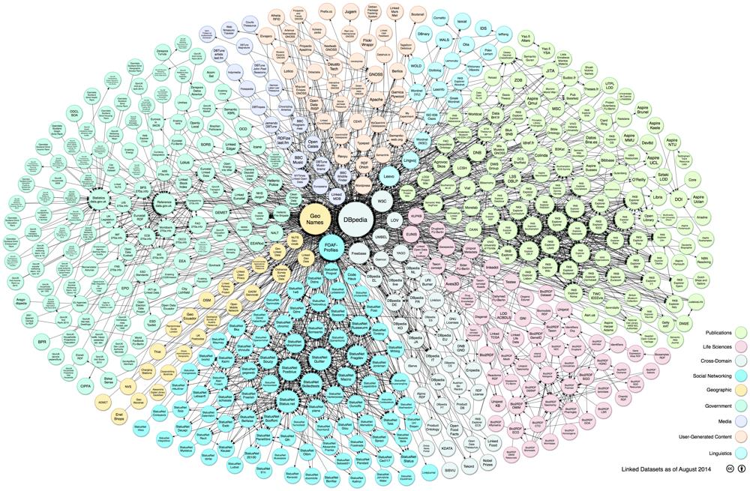
Linked Data & The Semantic Web
V440
http://www.w3.org/standards/semanticweb/

Slide 4


Webben (“web av länkade dokument”)
URL
URL
URL
URL

Slide 5
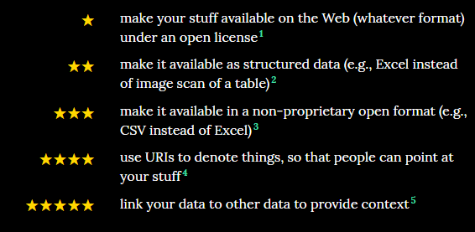

Linked data - Semantic Web (“web av data med innebörd”)

Slide 6
Varför en ontologi för V440?
Gör strukturen för och innehållet i V440 explicit och maskinläsbart
Använd RDF, RDFS, OWL som REPRESENTATION men behåll essensen
Gör strukturen direkt refererbar från andra standarder och format som t ex IFC och *GML
Genom att använda URI:er för identifikation
Ge möjlighet att mappa mot begrepp i andra standarder
Genom att använda standardiserad semantik (W3C) i ”Linking Rule Sets”/”Alignment ontologies”, dvs. separata ontologier som specificerar relationer mellan koncept på schema-nivå
Tillgång via standardiserade web-api:er
http GET, SPARQL endpoint
”På köpet”:
Öppet dataformat för både schema och data (XML, Json, Turtle, …)

Slide 7
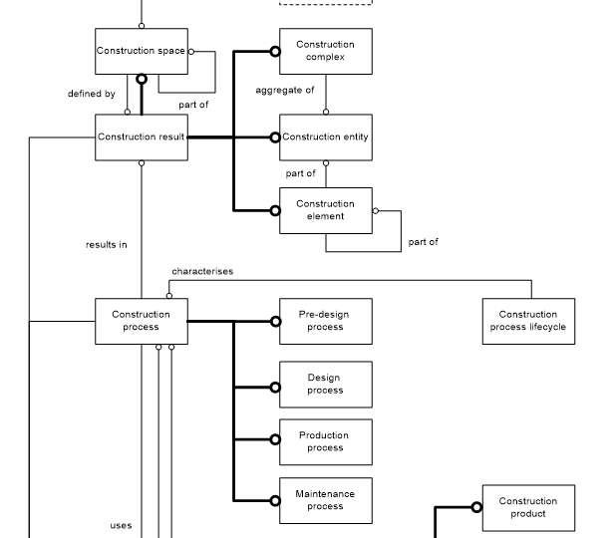
Inspiration från ISO 12006-2 Building construction — Organization of information about construction works — Part 2: Framework for classification
Construction complex
aggregate of construction entities serving at least one user activity or function
Construction entity
an independent unit of the built environment with a characteristic spatial structure, serving at least one user activity or function
Construction Entity part
constituent of a construction entity
Construction element
constituent of a construction entity with a characteristic technical function, form or position
Construction process
process which uses construction resources to achieve construction results
V440 handlar i grunden om klassifikation!

Slide 8
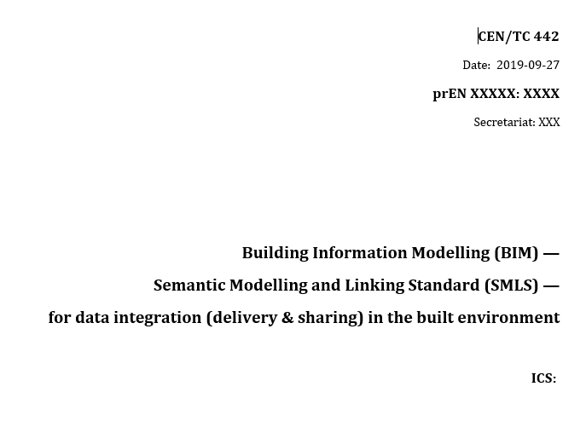
Pilot för CEN/TC442 Semantic Modelling and Linking Standard - Inklusive ontologin basicsemantics-owl
How to model
LoC 1 – Terminology & definitions alignment
Vocabulary/Thesaurus
LoC 2 – Data exchange/sharing
Ontology Open World
LoC 3 – Data integration
Ontology Closed World
Naming conventions
Decomposition
Quantity kind & Units
Quantity modelling
Conceptual (top level) modelling
How to link
LoC 1 – Weak linking
LoC 2 – Medium linking
LoC 3 – Strong linking

Slide 9
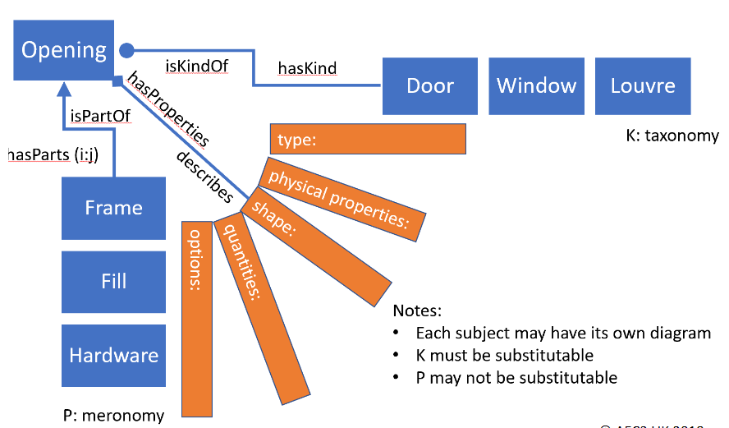
Basala koncept från RDF, RDFS and OWL för V440
v440:Vegbru
rdf:type owl:Class ;
v440:avsnitt "V-5.1" ;
v440:kapitel " V-5" ;
v440:kode "1"^^xsd:int ;
rdfs:label "Vegbru"@no ;
rdfs:subClassOf v440:Ordinar_bru_i_dagen ;
.
URI:er identifierar varje koncept
Definiera koncepten (klasser)
owl:Class, rdfs:label, rdfs:comment
Definiera taxonomin (isKindOf)
rdfs:SubClassOf
Definiera meronomin (isPartOf)
basicsemantics:hasPart (CEN/SMLS)
Definiera egenskaper (properties)
owl:xxxProperty
Koppla samman klasser och egenskaper
rdfs:domain/rdfs:range, owl:Restriction
Definiera annotation
T ex. fånga koder och annan info från V440

Slide 10
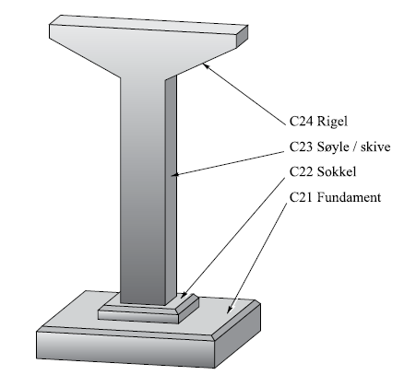
En liten utmaning
Handboken beskriver en hierarkisk struktur av klasser, men…
Den är inte alltid strikt i betydelsen av hierarkiska nivåer
T ex. taxonomier vs meronomier
rdfs/owl ska stödja semantisk ”reasoning” och behöver därför vara ”semantiskt strikt”
En klass är en mängd (set)
rdfs:subClassOf specificerar en sann delmängd (används för taxonomier)
Exempel: Pilar
I V440 är det ingen klar skillnad mellan
Relationen mellan Byggverkselement och Pilar (isKindOf) - taxonomi
och relationen mellan Pilar och Fundament (hasPart) - meronomi

Slide 11

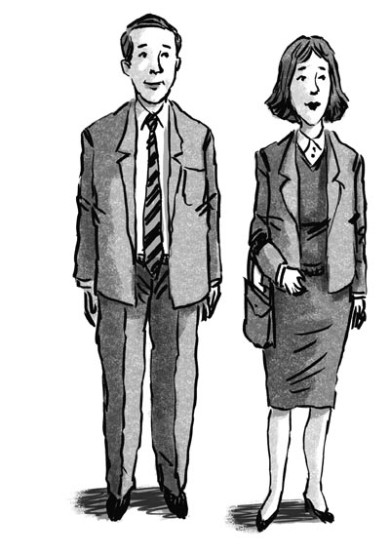
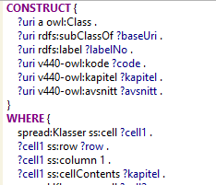



Prosessen
Förstå
V440
Definiera principer
Verifiera principer med domänexperter
Verifiering
Validering
Generera V440- ontologi via SPARQL/SPIN
Definiera
Excel- struktur
Bulk input från domän-experter
Konvertera excel till rdf (generisk spreadsheet-struktur)

Slide 12
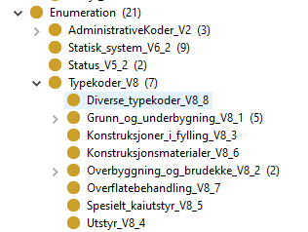
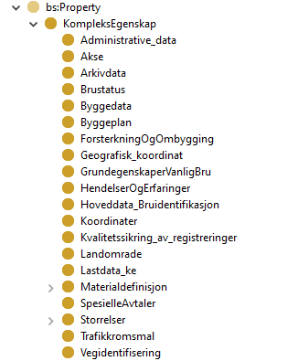
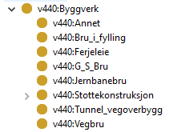
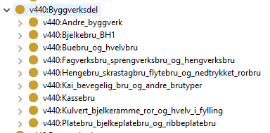
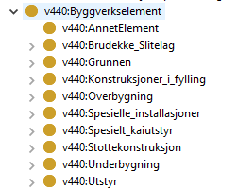
Ontologi
Properties (=Kap. 7 – Brudata)
Construction entity (=Byggverkskategori)
hasPart
hasPart
Construction entity part (=Byggverkstype)
Construction element (=Byggverkselement)

Slide 13
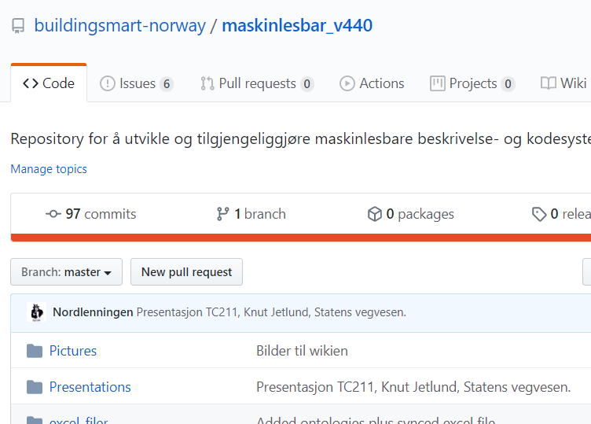
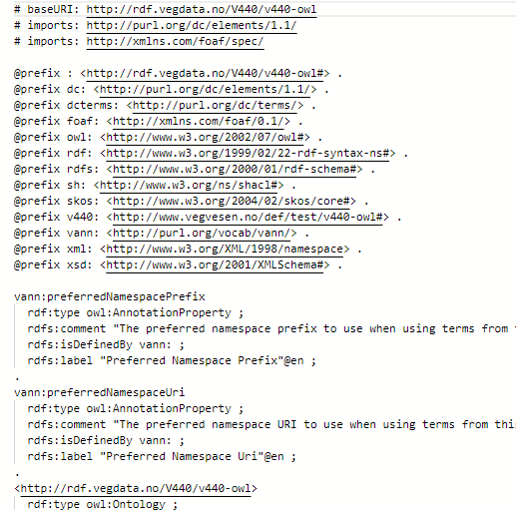
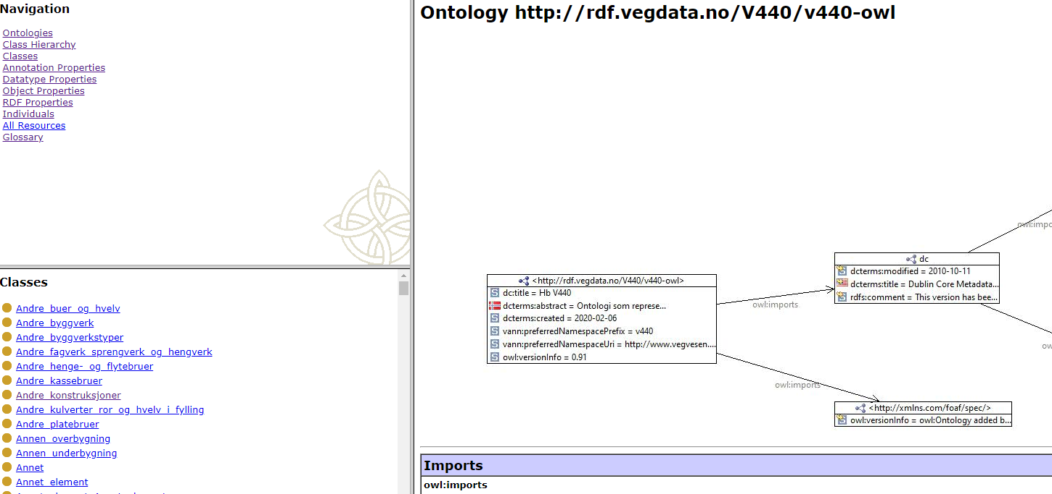
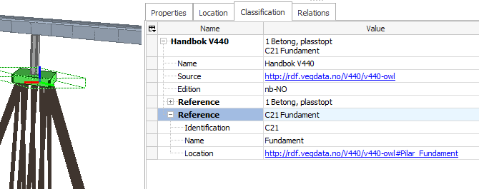
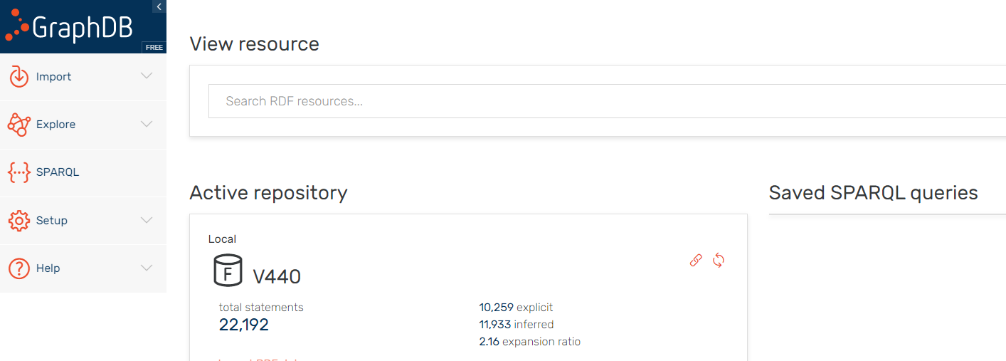
Interoperate:
GitHub
V440-ontologier online:
http://rdf.vegdata.no/V440/v440-owl
http://rdf.vegdata.no/V440/v440-brudata-owl
SPARQL endpoint
Exempel IFC + classification
Inbjudan till mjukvaruföretag
Använd ontologier i mjukvara
Demonstrationer

Slide 14
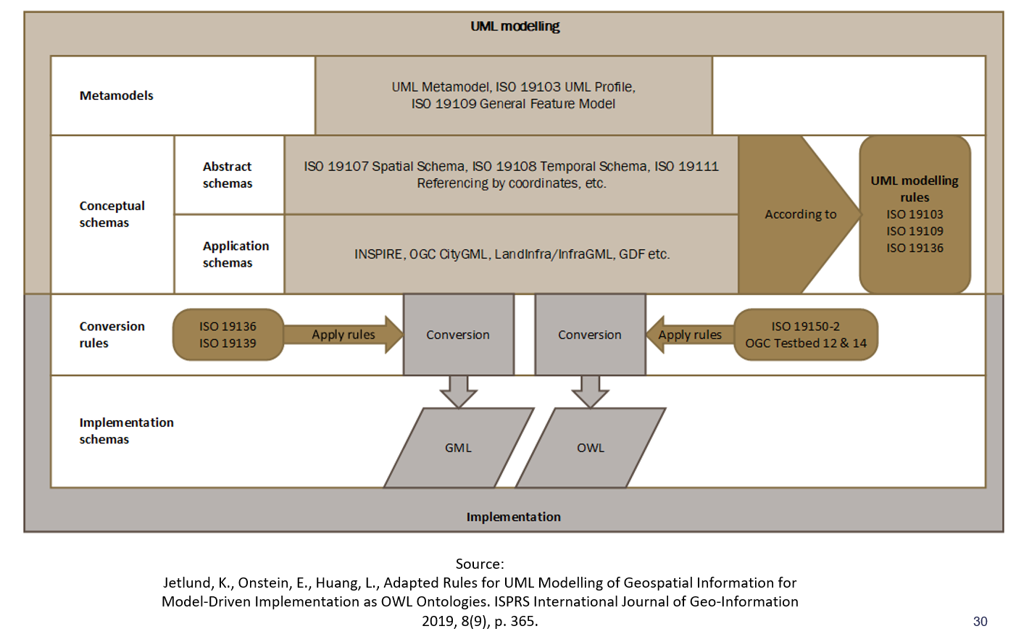

GML (SOSI, InfraGML, …)
=> OWL från UML applikationsschema med ett tastetryck

Slide 15
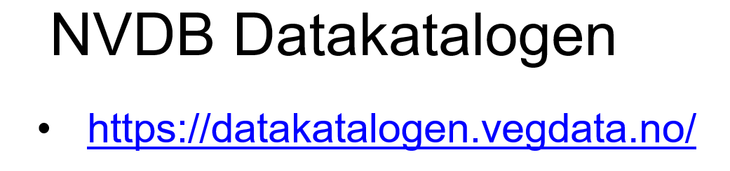

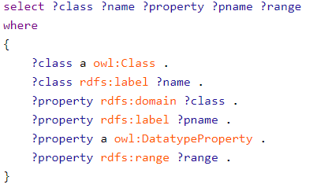
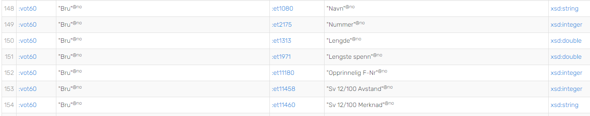
Knut Jetlund har genererat!!
Finns på samma SPARQL-server som V440

Slide 16
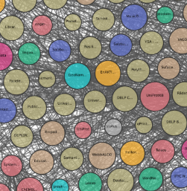
Möjligheter utöver nuvarande användning
Länka samman med exempelvis:
IFC 4.3 (inkl IFC Bridge)
Finns som IfcOWL
NVDB-OTL
Se fg slide => Kan genereras med ett tastetryck
SOSI-GML
Se fg slide => Kan genereras med ett tastetryck
V441
inspeksjon, skader, tiltak
SSN/SOSA?
sensorer, observationer, …

Slide 17
Extramaterial:
Crash course RDF, RDFS, OWL, SPARQL, Länkar…

Slide 18
Basic concepts
RDF
Resource Description Framework
RDFS
Resource Description Framework Schema
SPARQL
SPARQL protocol and RDF Query Language
OWL
Web Ontology Language

Slide 19
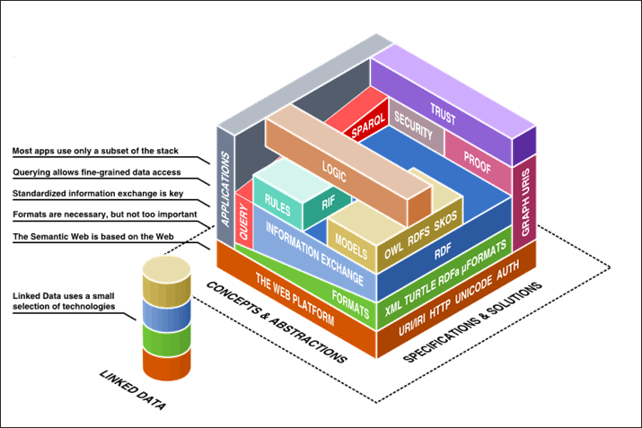
Technology Stack – Web technology

Slide 20

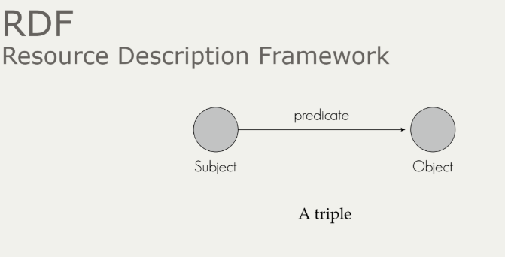
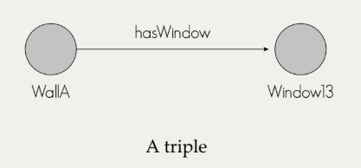
Basic Concepts
RDF – Resource Description Framework
:WallA
:hasWindow :Window13 .
A Fact!

Slide 21
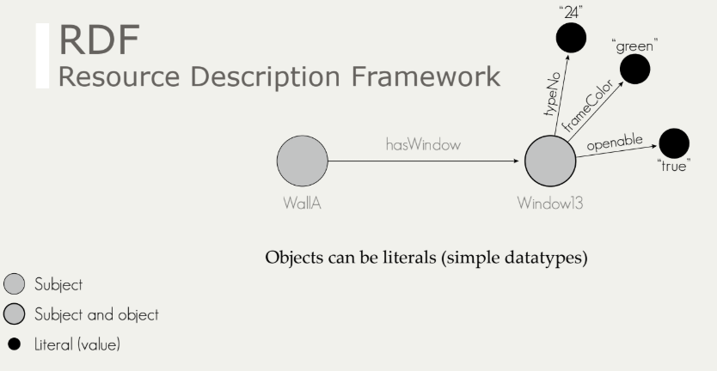
Basic Concepts
:WallA
:hasWindow :Window13 .
:Window13
:typeNo “24” ;
:frameColor “green” ;
:openable “true” .

Slide 22
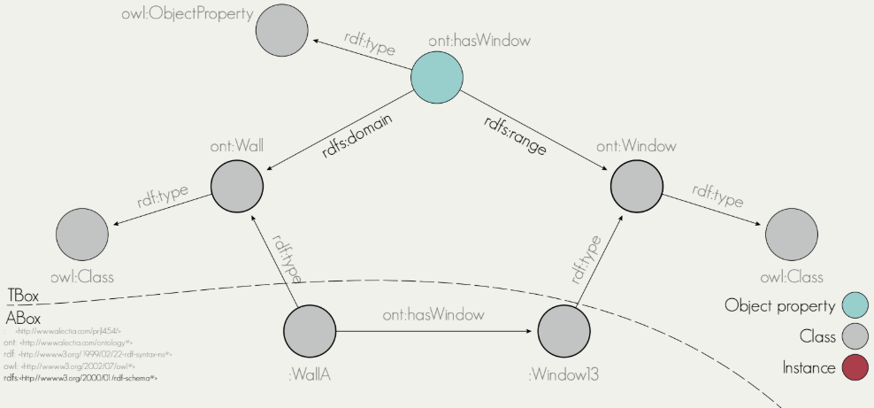
Basic Concepts
:WallA
rdf:type ont:Wall ;
:hasWindow :Window13 .
:Window13
rdf:type ont:Window .
ont:hasWindow
rdf:type owl:ObjectProperty ;
rdfs:range ont:Window ;
rdfs:domain ont:Wall .
rdf: = http://www.w3.org/1999/02/22-rdf-syntax-ns
rdfs: = http://www.w3.org/2000/01/rdf-schema
RDFS – RDF Schema

Slide 23
RDF/RDFS – important concepts
Classes:
rdfs:Class – ”the class of resources that are RDF classes”
rdfs:Literal – “the class of literal values such as strings and integers”
rdfs:Datatype – “the class of datatypes”
rdf:Property – “the class of RDF properties”
Properties:
rdf:type – “states that a resource is an instance of a class”
rdfs:range – “states that the values of a property are instances of a class”
rdfs:domain – “states that the any resource that has the property is an instance of a class”
rdfs:subClassOf – “states that all instances of one class are instances of another”
rdfs:subPropertyOf – “states that all instances related by one property are also related by another”
rdfs:label – “used to provide a human-readable version of a resource’s name”
rdfs:comment – “used to provide a human-readable description of a resource”

Slide 24
Basic Concepts
SPARQL – Querying the semantic web
SELECT ?wall ? Window
WHERE {
?wall rdf:type ont:Wall .
?wall ont:hasWindow ?window .
}
https://jena.apache.org/tutorials/sparql.html
Några v440-exempel senare…

Slide 25
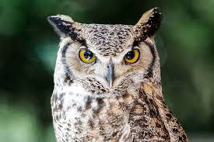

Basic Concepts
owl: = http://www.w3.org/2002/07/owl
OWL – Ontologies (RDFS++)
Web Ontology Language
OWL includes RDFS plus much more:
E.g. Class “Mother” is the intersection of classes “Parent” and “Woman”
E.g. My class “Wall” is equivalent to the class “IfcWall”
E.g. System-A:BridgeA is the same as System-X:BridgeX
OWL allows you to easily express the relationships between different ontologies using a standard annotation framework.
Semantic reasoning
Inferring new triples (knowledge) from existing triples
E.g. This individual belongs to “Parent” and “Woman” => Must be a “Mother”
Mother
Woman
Parent
rdf:type
rdf:type
rdf:type

Slide 26
OWL – Important concepts
owl:Class – “defines a group of individuals that belong together because they share some properties. owl:Class is a subclass of rdfs:Class”
owl:Restriction – “is defined as a subclass of owl:Class. A restriction class should have exactly one triple linking the restriction to a particular property, using the owl:onProperty property”
owl:DatatypeProperty – “one of two main categories of properties. It links individuals to data values”
owl:ObjectProperty – “one of two main categories of properties. It links individuals to individuals”

Slide 27
OWL – Important concepts
owl:intersectionOf – “the class extension contains precisely those individuals that are members of the class extension of all class descriptions in the list”
owl:unionOf – “the class extension contains those individuals that occur in at least one of the class extensions of the class descriptions in the list”
owl:complementOf – “a class for which the class extension contains exactly those individuals that do not belong to the class extension of the class description that is the object of the statement”
owl:equivalentClass – “class description has exactly the same class extension as another class description”
owl:disjointWith – “the class extension of a class description has no members in common with the class extension of another class description”

Slide 28
OWL – Important concepts
owl:equivalentProperty – “two properties have the same property extension”
owl:equivalentClass – “class description has exactly the same class extension as another class description”
owl:disjointWith – “the class extension of a class description has no members in common with the class extension of another class description”
owl:inverseOf – “relationship between owl:ObjectProperty such that for every pair (x,y) in the property extension of P1, there is a pair (y,x) in the property extension of P2, and vice versa”
owl:FunctionalProperty – “a property that can have only one (unique) value y for each instance x”
owl:TransitiveProperty – “if a pair (x,y) is an instance of P, and the pair (y,z) is also instance of P, then we can infer the the pair (x,z) is also an instance of P.”
owl:SymmetricProperty – “if the pair (x,y) is an instance of P, then the pair (y,x) is also an instance of P.”

Slide 29
OWL – Read more and learn
OWL language guide : https://www.w3.org/TR/owl-guide/
Protégé pizza tutorial : http://mowl-power.cs.man.ac.uk/protegeowltutorial/resources/ProtegeOWLTutorialP4_v1_3.pdf

Slide 30
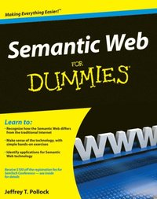
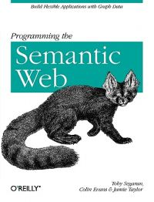
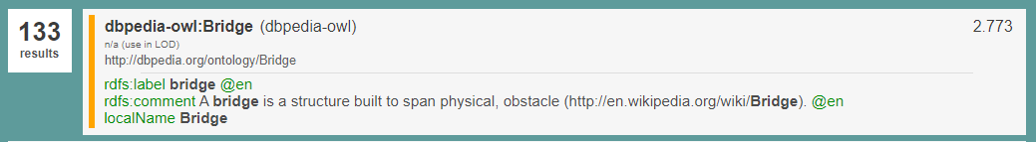
LD/SW – Read more and learn
W3C - OWL language guide
Intro
5 star open data
Semantic web for dummies
Programming the semantic web
Linked Open Vocabularies
Protégé pizza tutorial
DBPedia SPARQL endpoint
Linked Geodata
SPARQL Endpoint
LinkedDataHub

